Slide 1
Project Cost & Estimation
Class 3
Project Cost Management
Estimation
Budget
Cost Control
Free Powerpoint Templates

Slide 2
Project Cost Management
Estimate Costs
The process of developing an approximation of the monetary resources needed to complete project activities.
Determine Budget
The process of aggregating the estimated costs of individual activities or work package to establish an authorized cost baseline.
Control Costs
The process of monitoring the status of the project to update project budget and managing changes to the cost baseline.

Slide 3
Estimation
The process of forecasting or approximating the time and cost of completing project deliverables
A valuation based on opinion or roughly made from imperfect or incomplete data
A standard for comparison of actual and plan throughout the file of the project

Slide 4
7 steps of estimating:-
Define job and environment
Break job into elements
Choose an estimation technique
Calculate and check the calculations
Document the calculation
Assess the risk in the estimate
Allow for support overheads

Slide 5
To be considered:
Scope baseline
Project schedule
Human resource plan
Risk register
Enterprise Environmental factors

Slide 6
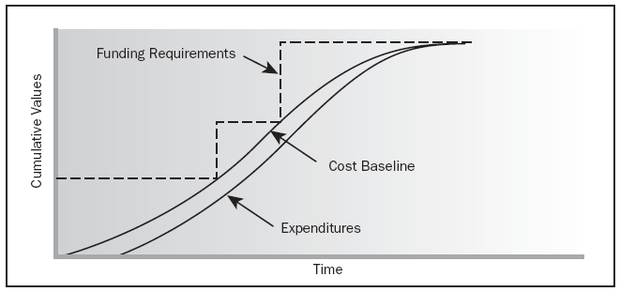

Slide 7
Estimating Project Times and Costs
Macro Approaches (Top-down)
Ratio Methods – Concept, “need” phase to get initial duration & cost estimation
Apportion Method – extension of Ration method
Function Point Methods for Software and System Projects – weight calculation, “function points”
Learning curves
Micro Approaches (Bottom-up)
Template Method – similar to past project
Parametric Procedures applied to specific task cost per m2
Detailed estimates for the WBS work packages
A Hybrid : Phase estimating

Slide 8
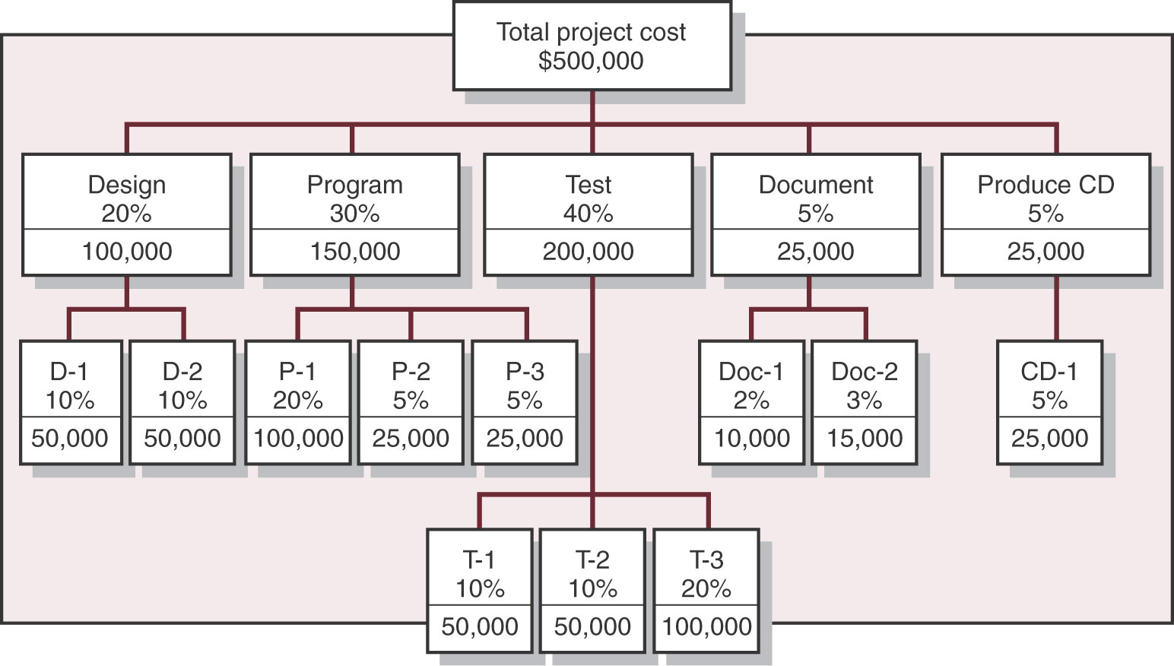
Apportion Method of Allocating Project Costs

Slide 9
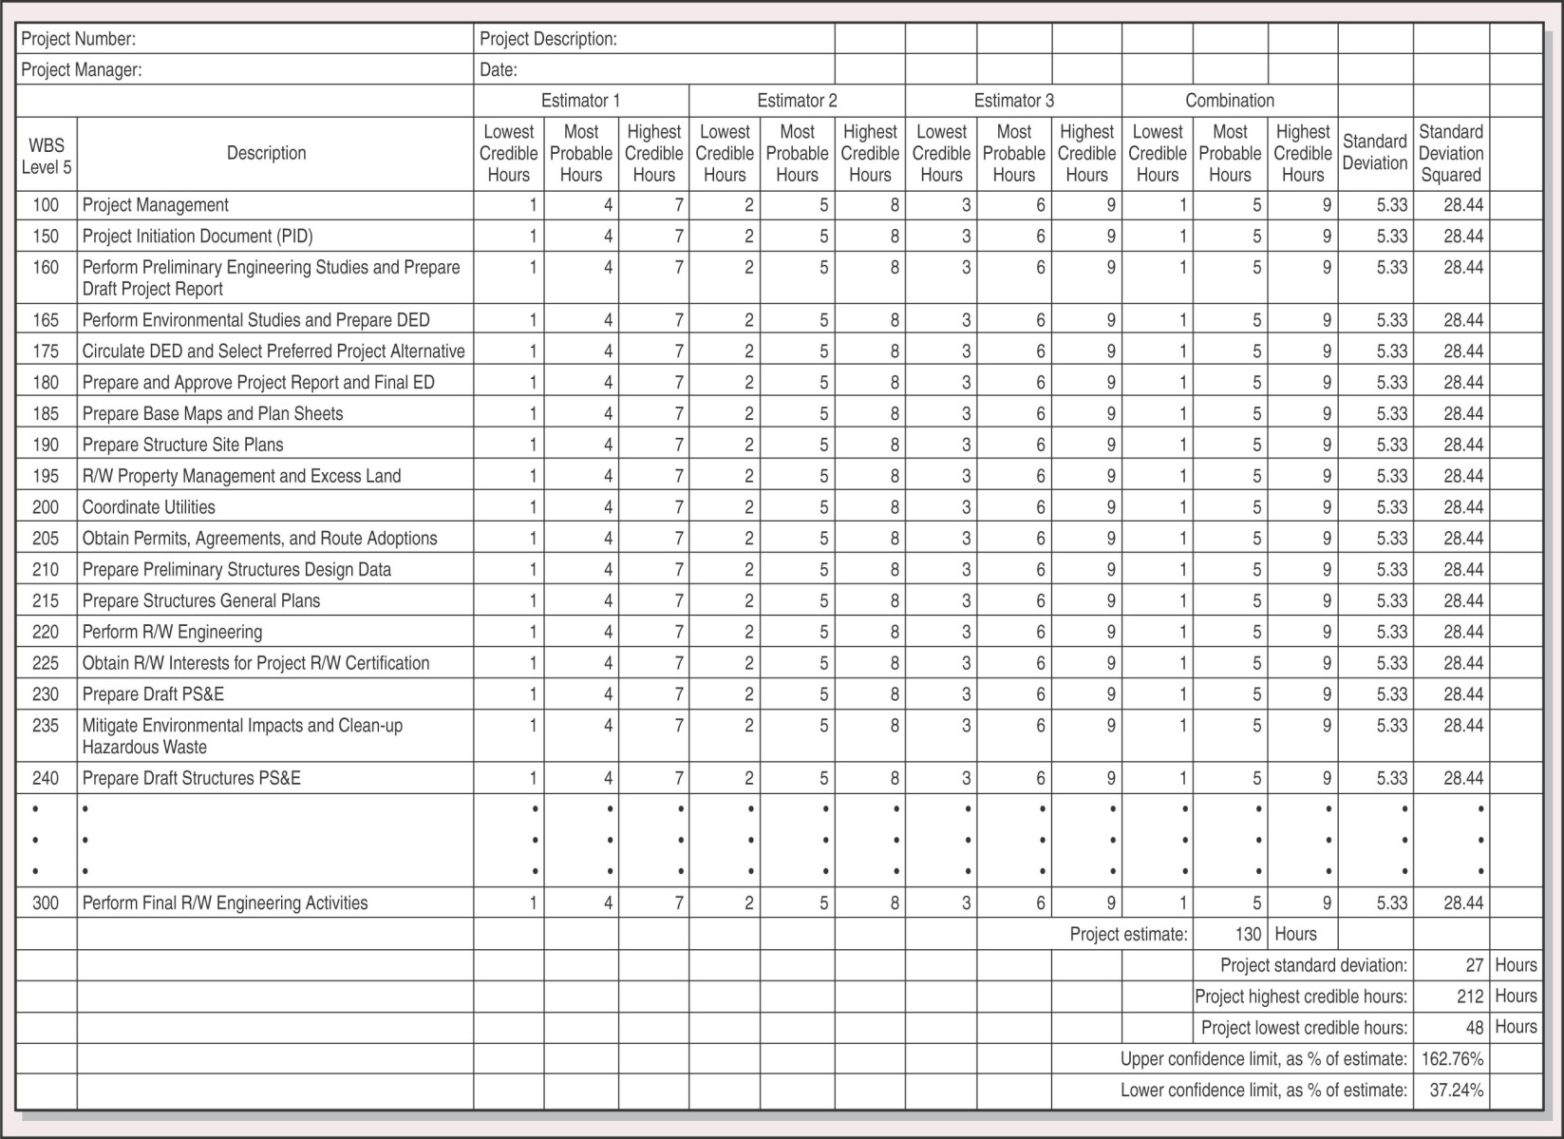
Support Cost Estimate worksheet

Slide 10
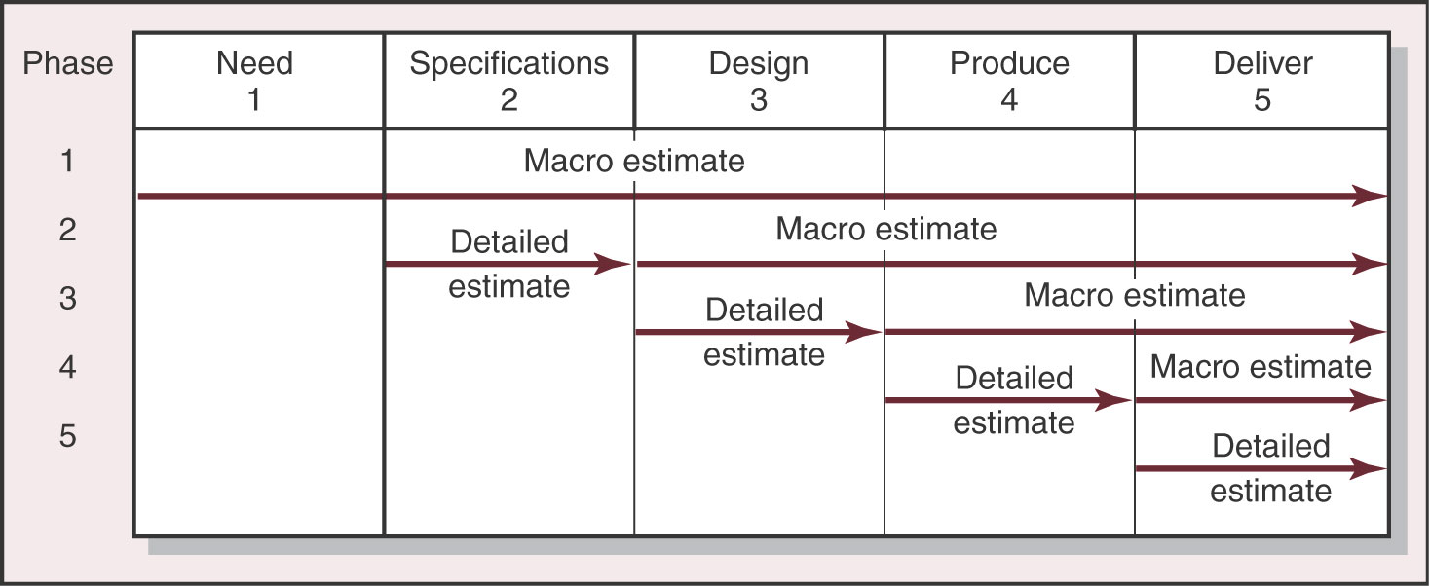
Phase Estimating Over Project Life Cycle

Slide 11
Types of Costs
1. Direct Costs
Labour
Materials
Equipments
Other
2. Project Overhead Costs
3. Administrative Overhead Costs

Slide 12
Estimating Guidelines for Times, Costs, and Resources
Responsibility
Use several people to estimate
Normal conditions
Time units
Indepoendence
Contingencies
Risk assessment

Slide 13
Authority
Authority :
the formal or legitimate authority specified in a charter gives a project manager the authority to act in the name of the sponsoring executive or on behalf on the organization.
Authorization for Expenditure (AFE) :
is the process by which an organization submits a proposal for a project's budget to investors for their approval.
Procurement Authority

Slide 14
Budget
generally a list of all planned expenses and revenues → forecast of Total Expenditure
an organizational plan stated in monetary terms

Slide 15
Advantages of Budgeting:
Think about and plan for the future
Means of allocating resources
Communicating plans
Coordinate activities

Slide 16
The success of budgeting depends upon:
The degree to which top management accepts the budget program as a vital part of the company’s activities.
The way in which top management uses budgeted data.
How real the budget is!

Slide 17
Progress Claim
Monetary claim from Contractor which reflect the actual progress measured by the agreed cut-off date (monthly).
Claim against Total value of the project.

Slide 18
Change Management
In any project there are likely to be changes to the original plan during the course of the project.
Changes may arise due to:-
- The business case altering
- The need to find a way round a problem
- Identifying a better way to meet objectives
- The scope of project altering

Slide 19
Changes come from many sources ; clients, owner, project manager, team members, occurrence of risk events.
A change control mechanism is necessary to ensure that such changes are handled in a managed and controlled way in order to keep the project on track.
Any proposed change to the agreed deliverables of project should be subject to an impact analysis → Time/ Cost/ Quality

Slide 20
Change control system:
Identify proposed changes
List expected effects of changes on schedule and budget
Review, evaluate, and approve or disapprove changes formally
Negotiate and resolve conflicts of changes
Communicate changes to parties affected
Assign responsibility for implementing changes
Track all changes that are to be implemented

Slide 21
Cost Management
Processes concerned with ensuring that the protect is completed within the approved budget.
Cost estimation and budgeting
Cost control = concerned with influencing the factors which create changes to the cost baseline to ensure changes are beneficial and managing the actual changes when they occur

Slide 22
Project Cost control includes:
Influencing the factors that create changes to the authorized cost baseline
Ensuring that all changes requested are acted on a timely manner
Managing the actual changes when and as they occur
Ensuring that cost expenditures do not exceed the authorized funding, by period and in total for the project
Monitoring cost performance to isolate and understand variances from the approved cost baseline
Monitoring work performance against funds expended

Slide 23
Cost control outputs
- Revised cost estimates
- Budget updates
- Modifications to the cost information
- May require additional planning

Slide 24
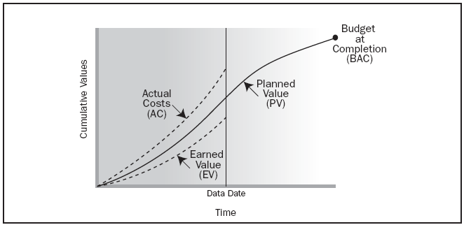
Cost control Tools and Techniques
Earned Value Management (EVM)

Slide 25
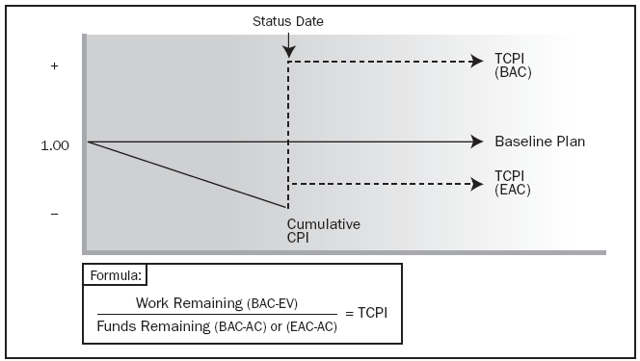
2. Forecasting
3. To-complete performance index (TCPI)

Slide 26
Finance Management
How firms raise and use funds to make short-term and long-term investments
Risk – return
Accounting Management - the practical application of management techniques to control and report on the financial health of the organization. This involves the analysis, planning, implementation, and control of programs designed to provide financial data reporting for managerial decision making.

Slide 27
You make the failure complete, when you stop trying

