Slide 1
Contracting for Projects
Class 5
Contract Management
Managing Dispute
Risk Management
Free Powerpoint Templates

Slide 2
Contract Management
Contracting Process
is the application of knowledge, skill sets, tools, and techniques to the total acquisition process in order to meet or exceed the organization’s needs and expectations with respect to:
Scope – Time – Cost - Quality

Slide 3
Scope: What has to be accomplished by the contracting process? What is the desired outcome state?
Time: When do all activities need to occur for a contracting process to be completed successfully?
Cost: What costs must be factored into the process to support sound decision making to advance the project?
Quality: What would constitute a high quality deliverable that exceeds expectations?

Slide 4
Primary purposes of the contracting:
It reflects the objectives of both parties
It formally documents the rights, duties, obligations, promises of the parties entering into the agreement
In the event of a breach, a contract properly written, provides remedies with the full force of the applicable laws.

Slide 5
Essential Elements of a Valid Contract:
Signed official purchase order
Including variations to purchase order
Scope of supply
Delivery requirements
Defined conditions of contract
Including amendments and modifications
Contract plan

Slide 6
Clear terms of payment
Payment milestones
Comprehensive technical specifications
Technical description and drawings
Standards and regulations
Quality plan and certification
Health, safety and environmental requirements

Slide 7
Type of contracts:-
Consolidated Sourcing Contract
Alliancing Contracts
Frame Agreement Contracts
EPC Contracts
Non-commercial Contracts

Slide 8
Consolidated Sourcing Contracts:
Provides total cost focus
Creates cycle-time reduction and process improvement
Allows full range of products and services
Can provide flexibility for users of goods and services

Slide 9
Alliancing Contracts:
Clients and Contractors in partnership (teamwork)
Set duration of time
“Fit for Purpose” equipment and services
Work together to reduce time and cost

Slide 10
Frame Agreement Contracts:
Contracts are generally awarded for 5-10 years
Shopping list for equipment and services
Client and contractor in partnership for the duration
Work together to improve quality and specifications of equipment and materials
Reward both sides

Slide 11
EPC Contracts:
Engineering, Procurement, and Construction
Common for large scale and complex projects
Under an EPC contract, a contractor is obliged to deliver a complete facility to a developer
Turn-key project/ EPCI/ EPIC

Slide 12
Non-commercial contracts:
Government agency or not-for-profit organization
Supplying goods or services without the expectation of a profit

Slide 13
Contract formation
Fixed-Price Contracts
Cost-Reimbursement Contracts

Slide 14
Fixed-Price Contracts:
Require the contractor to deliver a final product and include a maximum limit on contract price. If contract costs exceed that limit, the contractor will sustain a loss.
Consider fixed-price type contract when the contract risk is relatively low or well defined, and the contractor can confidently estimate an accurate contract cost.
→ competition will decrease
→ costs will increase

Slide 15
Cost Reimbursement Contracts:
Provide for all allowable contract costs whether or not the contractor completes all requirements
Consider a cost-reimbursement type contract when cost risk is high and the contractor cannot estimate cost with reliable accuracy

Slide 16
Contract Administration
Objectives of Contract Admin :
to ensure that all the conditions of the contract are met by both parties and that all the objectives of the organization for entering into an agreement with an outside source are satisfied.

Slide 17
Contract Administration plan:
Contract Number Dates for deliverables
Contractor Performance checklist
Service to be provided Record of changes
Date awarded Schedule audits
Expiration term Customer surveys meeting
Renewal terms
Location of contract files
Contract Focal point of both parties

Slide 18
Managing Disputes
Sources of Contract Disputes:
Errors and Omissions
Insufficient time to bid
Changed conditions (minor changes with major consequences)
Personalities (common sense, unbalanced team – too many chiefs)
Unrealistic expectations
Lost in translation

Slide 19
Avoiding Disputes
Contract Administration
Single point of contract
Orderly records
One official language
Using avoidance techniques
No meeting without clear agendas
Record all minutes and action steps
Reach agreement in principle

Slide 20
Minimize Effects
Encourage dialogue across project
Carry out actions in time allocated
Complete effective corrective actions in spite of commercial disputes
Be decisive
Artful Negotiations
Provide background to support your argument
Compromise if good ideas are provided
Win-win

Slide 21
Implement of the Contract
A lot of effort is put into forming and agreeing the components of the CONTRACT in order to create a “rule book” by which both the COMPANY and CONTRACTOR must follow during the currency of the project. Unfortunately in many instances the “rule book” is only referred to when a dispute or an ambiguity occurs.

Slide 22
By familiarizing ourselves and using this “rule book” on a regular basis the benefits are:
1.The Contractual and Commercial Integrity of the COMPANY is maintained
2.The project shall progress in a less confrontational manner (more efficiently)
3.Potential disputes/claims are mitigated at an early stage
4.Project costs are controlled more efficiently
5.CONTRACTOR is less able to take advantage of COMPANY

Slide 23
WHAT FORMS THE CONTRACT
The components of the CONTRACT are;
1.The Articles of Agreement
Defining the Contractual and Commercial rules
2.Annexes – Containing forms of certificates i.e Bank Guarantees, Design Endorsement, handover certificates and the CONTRACTOR/COMPANY agreed clarifications/ qualifications during the tender negotiation period.
3.The Exhibits – Defining
•The Scope of Work
•The Contract Price
•Work Time Schedule
•The Design
•Performance Guarantees
•Coordination Procedures
Quality Assurance and Quality Control
•Company Free Issue Items
•Approved Subcontractor and Vendor Lists
•Contractors Key Personnel
•Safety Requirements

Slide 24
What does not kill you,
makes you stronger

Slide 25
Risk Management
“Processes concerned with identifying analyzing and responding to uncertainty”
Uncertainty:
Lack of knowledge of future events
Knowledge of a risk’s probability of occurrence but not a quantification
Project risk = Scope Time Cost Quality

Slide 26
Project Risk Management:
Identifying, analyzing, and responding to risk factors throughout a project in the interest of project objectives
When is the greatest degree of uncertainty encountered in a project?
When is the most effective time for achieving the greatest impact on project results?
Conceptual Phase
Planning Phase

Slide 27
Risk Management Process
Risk Identification
Risk Assessment
Risk Response Development
Risk Response Control

Slide 28
Step 1 Risk Identification
Risk identification = Process of determining what resources of Risk and which risk events may reasonably be expected to affect the project./ WBS
Output of risk identification:-
Sources of risk that may affect project
Risk events
Risk symptoms

Slide 29
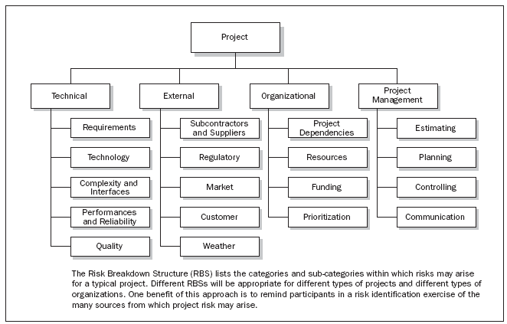
Example of Risk Breakdown Structure

Slide 30
Step 2 Risk Assessment
Analyze risks in terms of:
Severity of impact
Likelihood of occurring
Controllability

Slide 31
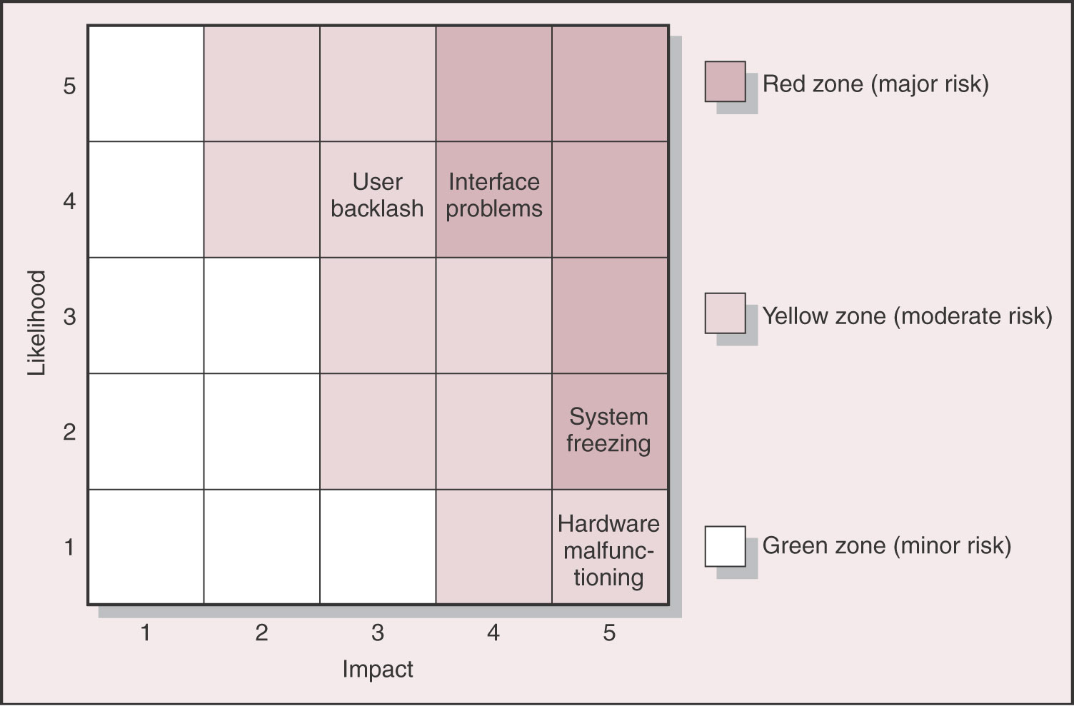

Slide 32
Step 3 Risk Response
Develop a strategy to reduce possible damage
Develop contingency plans
Mitigating Risk – reduce likelihood/ reduce impact
Transferring Risk
Sharing Risk
Retaining Risk

Slide 33
Step 4 Risk Response Control
Implement risk strategy
Monitor and adjust plan for new risks
Establish and environment in which participants feel comfortable raising concerns and admitting mistakes
Documenting responsibility/ each identified risk should be assigned
Team need to be vigilant in monitoring potential risks

Slide 34
Tools for risk management:
Monte Carlo Simulation
PERT Simulation
Decision Trees
Risk Analysis
- Brainstorming
- Delphi method
- Sensitivity Analysis
- SWOT Analysis
Strengths
Weaknesses
Opportunities
Threats

Slide 35
The reward of a thing well done
is to have done it

