Slide 1
Project Planning
Class 2
Organization Structure & Culture
Work Breakdown Structure
Responsibility Matrix
Manpower Plan
Project Planning
Free Powerpoint Templates

Slide 2
Project Planning
Project Planning is:
“Coping with uncertainty by formulating courses of action to achieve specified results.”
A Plan is:
“a specific documented intention consisting of an objective (end) and action statement (means).”
States: What, When, and How something is to be done.

Slide 3
Planning is commonly carried out in relation to:
Timing of the method and order of work → scheduling
The use of money → budgeting or financial planning
The use of non-monetary resources including people → Human Resources planning, Materials, Equipment
A Strategy for quality → Quality plan
Safety issue → according to law requirements

Slide 4
Cost of Planning
Total Project Cost
Cost - $
Project Cost
Planning Cost
0
Percentage of Project cost spent on planning

Slide 5
Organization Structure
Functional Organizations
Dedicated Teams
Matrix Organization
Virtual Organization

Slide 6
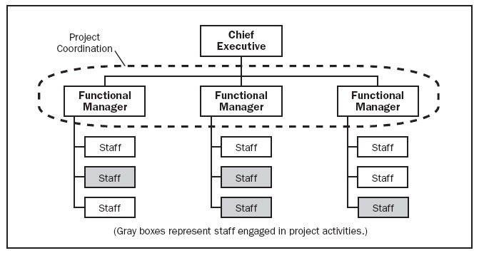
1. Functional Organization
Using the existing functional organization
Share resources

Slide 7
Functional Organization
Advantages:-
Projects are completed within the basic functional structure of the parent organization
There is maximum flexibility in the use of staff
Normal career paths within a functional division are maintained

Slide 8
Functional Organization
Disadvantages:-
Projects often lack focus
Poor integration across functional units
Takes longer to complete projects
The motivation of people assigned to the project can be weak

Slide 9
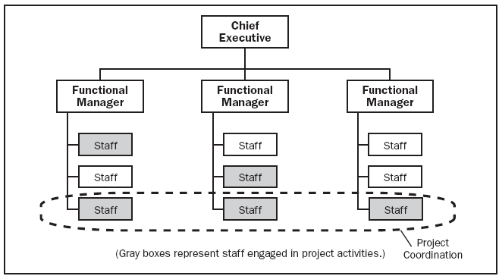
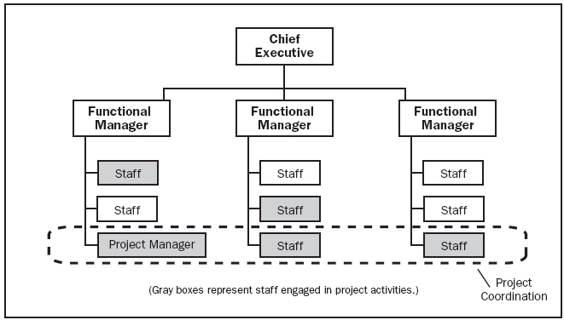
Comparison

Slide 10
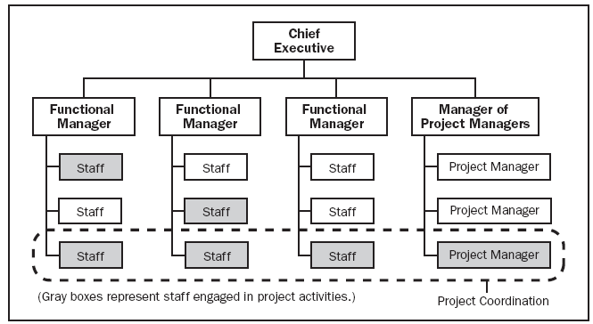
Strong Organizational Pattern

Slide 11
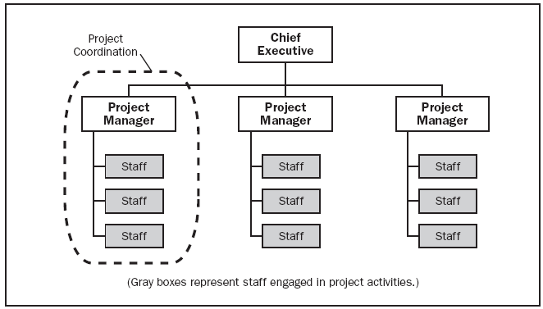
2. Dedicated Teams
Teams operate as separate units from the rest of the parent organization
A full-time project manager is designated

Slide 12
Dedicated Teams
Advantages:-
Completing a project that does not directly disrupt ongoing operations
Projects tend to get done more quickly
High level of motivation and cohesiveness often emerges within the project team

Slide 13
Dedicated Teams
Disadvantages:-
Expensive
Take on an entity of their own
Technical expertise is limited
Dilemma of what to do with personnel after the project is completed

Slide 14
3. Matrix Organization
2 chains of command; one along functional lines and the other along project lines

Slide 15
Matrix Organization
Advantages:-
Resources can be shared across multiple projects
Stronger project focus; formally designated project manager
Reasonable access to the entire reservoir of technology and expertise
Flexible utilization of resources within the firm

Slide 16
Matrix Organization
Disadvantages:-
Tension between functional managers and project managers
Tend to conflict and competition for scarce resources
Violates the management principle of unity of command (2 bosses)

Slide 17
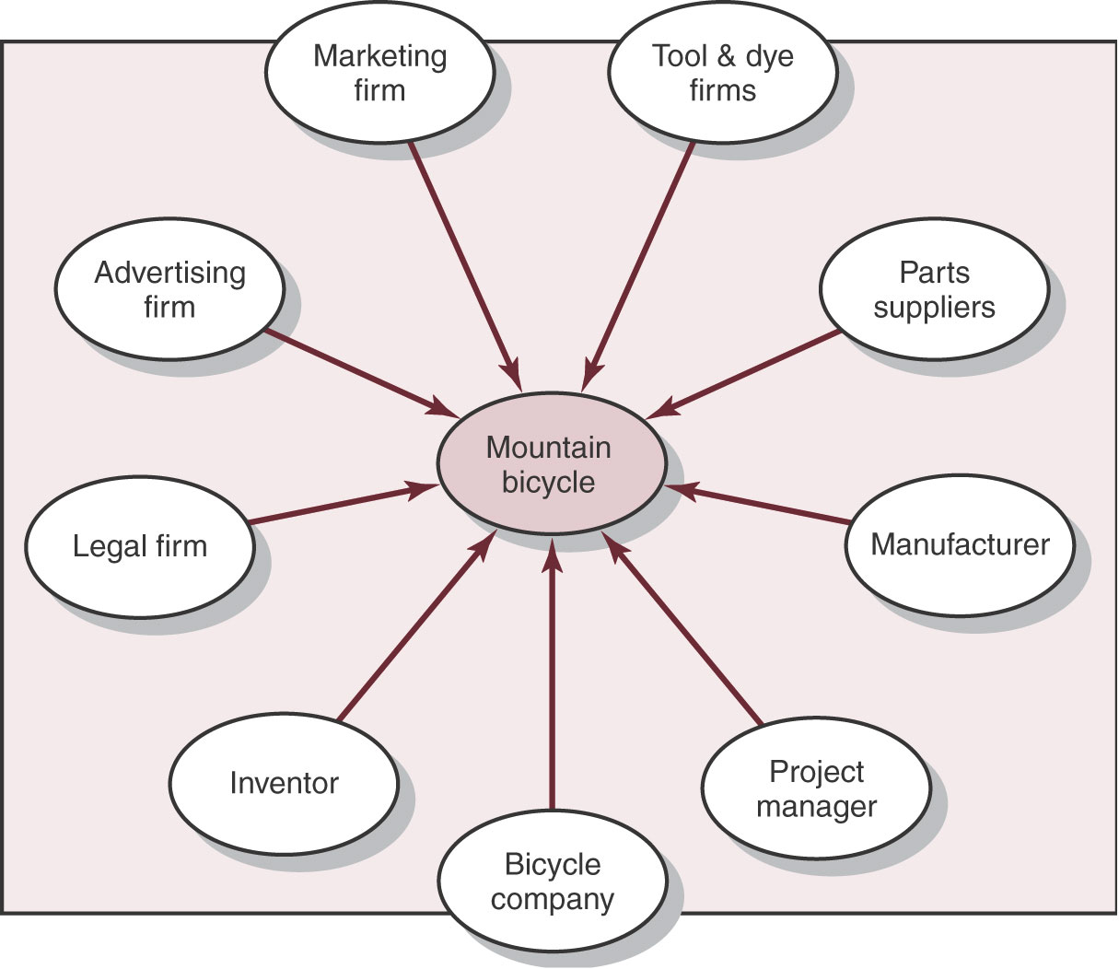
4. Virtual Organization
Hub; Core firm; Star
Corporate downsizing

Slide 18
Virtual Organization
Advantages:-
Cost reduction
High level of expertise and technology
Increase flexibility

Slide 19
Virtual Organization
Disadvantages:-
Requires close collaboration and mutual adjustment
Potential loss of control over the project
Interpersonal conflict, do not share same values, priorities, cuture

Slide 20
Organizational Culture
“a system of shared norms, beliefs, values, and assumptions, which bind people together, creating shared meanings.”
10 Primary characteristics:
Member identity Job Organization
Team emphasis Individual Group
Management focus Task People

Slide 21
4. Unit integration
Independent Interdependent
5. Control Loose Tight
6. Risk tolerance Low High
7. Reward criteria Performance Other
other : seniority, non-performance factors
8. Conflict tolerance Low High
9. Means-ends orientation Means Ends
10.Open-system focus Internal External

Slide 22
Planning Process
Develop Project Management Plan
Collect requirements
→ Requirements documentation
→ Requirements management plan
→ Requirements traceability matrix
3. Define Scope
→ Project Scope statement
→ Project document updates
4. Create WBS

Slide 23
5. Define activities
→ Activity list
→ Milestone list
6. Sequence Activities
→ Project schedule network diagrams
7. Estimate Activity resources
→ Activity resource requirements
→ Resource breakdown structure
8. Estimate activity durations
9. Develop schedule
10. Estimate costs

Slide 24
11. Determine Budget
→ Cost performance baseline
→ Project funding requirements
12. Plan quality
→ Quality management plan
→ Quality metrics
→ Quality checklists
→ Process improvement plan
13. Develop Human resource Plan
14. Plan communications
15. Plan Risk management

Slide 25
16. Identify Risks
→ Risk register
17. Perform Qualitative/ Quantitative Risk Analysis
18. Plan Risk responses
→ Risk related contract decisions
→ Project Management plan updates
19. Plan procurements
→ Procurement management plan
→ Source selection criteria

Slide 26
Work Breakdown Structure
Work Breakdown Structure (WBS)
“document that describes all the work that has to be done to complete the project”
Organization Breakdown Structure (OBS)
“represents a hierarchy of the company managing the project. By linking the OBS with the WBS or PBS, this will identify who is responsible for performing the work packages”
Product Breakdown Structure (PBS)
“represents a hierarchical view of the physical assemblies, sub-assemblies, components and parts needed to manufacture the product”

Slide 27
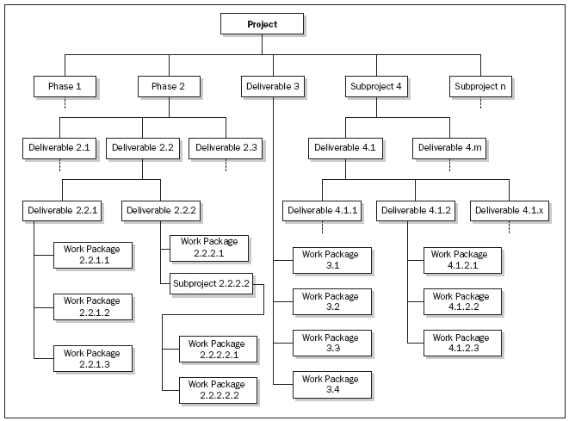
WBS

Slide 28
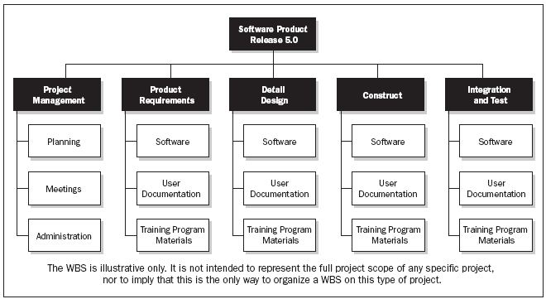

Slide 29
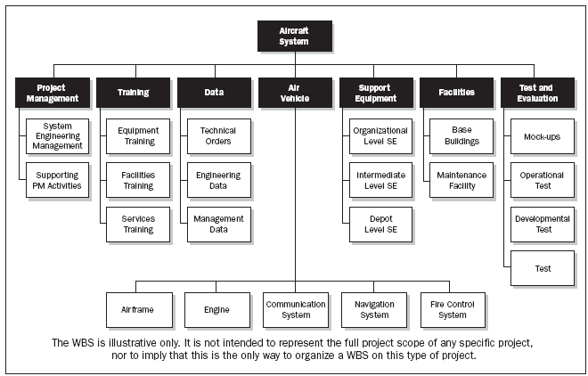
PSB

Slide 30
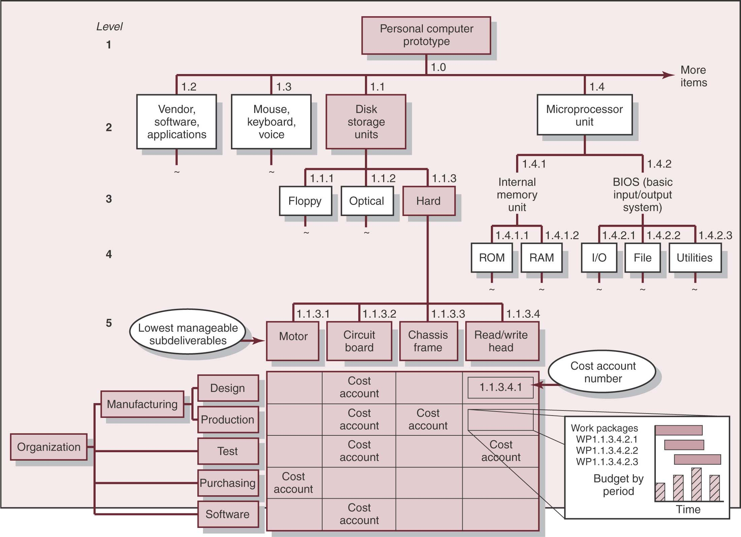
Integration of WBS and OBS

Slide 31
Cost Breakdown Structure (CBS)
“represents the financial breakdown at the project into budgets per work package”
Contract Breakdown Structure (CBS)
“represents the relationships between the client with the contractor. At the lowest level this could link the purchase orders with the account invoices”

Slide 32
WBS:
Any significant project can be broken down into several major sub-projects
Backbone of the planning and control system
Mind map which helps to break complexity down into simple manageable components

Slide 33
Hierarchical Breakdown of the WBS:
Level
Hierarchy
Description
1
Project
Complete Project
2
Deliverable
Major Deliverable
3
Sub-deliverable
Supporting Deliverable
Lowest sub-deliverable
Lower management
Responsibility level
4
Cost Account
Grouping of work packages for
Monitoring progress and
responsibility
5
Work Package
Identifiable work activities

Slide 34
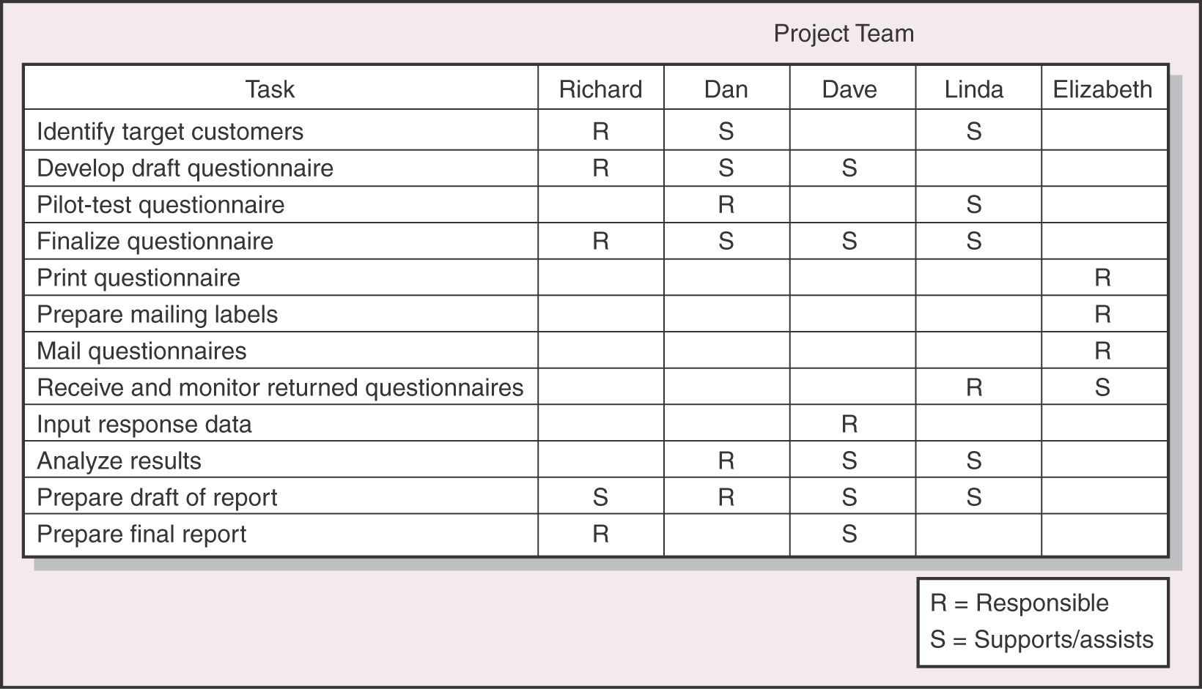
Responsibility Matrix
Summarizes the tasks to be accomplished and who is responsible for what on a project

Slide 35
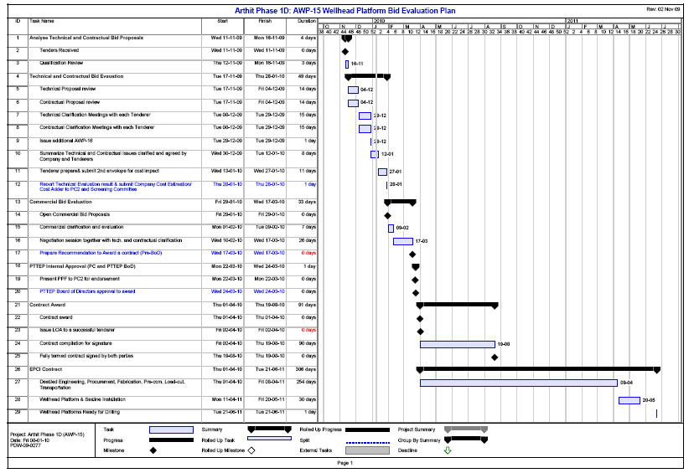
Schedule

Slide 36
Deliverables
Deliverables - the expected outputs over the life of the project. Deliverables typically include time, quantity, and/or cost estimates.
Approved Software, Products, Concluded report of studies, etc.

Slide 37
Time Management
Programs / Schedules
Owner can use the program for monitoring the contractor’s performance, and assessing claims for extensions of time.
Contractor’s program needs to incorporate the programs of sub-contractors.
It forms part of the contract, and any changes from it is a change in the contract.
Programs allow the contractor to do the work at his preferred sequencing and pace, but failure to meet the program may be a breach of contract.

Slide 38
Contractor’s program may include a time contingency.
This is for the benefit of the contractor, not to be used by the owner.
Extensions of time are granted where the owner causes a delay, or a delay stipulated in the contract occurs, where the delay is to a critical activity.

Slide 39
As Executed programs/ schedules
Programs indicate changes to the original program including delays, variations, and agreed changes.
As-Built/ As-Constructed/
As-Implemented/ Factual

Slide 40
Delays
If a delay is caused by the owner, then the contractor is entitled to an extension of time and full costs.
If a delay is caused by the contractor, must responsible without extension of time and costs.
If a delay is not caused by the owner or contractor (neutral delay), then the contractor is commonly entitled to an extension of time but not costs. (depends on clauses in the contract says who is responsible for what).
Time delay claims require substantiation (evidence).

Slide 41
Late completion is commonly remedied by liquidated damages.
This should be a reasonable estimate of the loss incurred by the owner due to not having possession of the completed works.
Acceleration maybe initiated.

Slide 42
Project Monitor and control process
Monitor and Control Project work
→ Change requests
→ Project Management plan updates
2. Perform integrated change control
3. Verify scope
→ Accepted deliverables
4. Control scope
→ Work performance measurements
5. Control schedule
→ Work performance measurements

Slide 43
6. Control costs
→ Budget forecast
7. Perform quality control
8. Report performance
9. Monitor and control risks
10. Administer Procurements

Slide 44
Monitoring
Monitoring involves collecting and recording information about the output or performance of the project.
Monitoring implies:
- Regular progress reports
- Analysis
- Regular project review meetings

Slide 45
Data collection
- Materials quantity, type, cost, arrival
- Equipment quantity, type, cost, arrival, departure, productivity
- Labour quantity, type, cost, arrival, departure, productivity
- Work quantity, quality, type, cost
- Time activities
- Changes
- Overheads

Slide 46
Pareto’s principle
In 1906, Italian economist Vilfredo Pareto created a mathematical formula to describe the unequal distribution of wealth in his country, observing that twenty percent of the people owned eighty percent of the wealth. In the late 1940s, Dr. Joseph M. Juran inaccurately attributed the 80/20 Rule to Pareto, calling it Pareto's Principle. While it may be misnamed, Pareto's Principle or Pareto's Law as it is sometimes called, can be a very effective tool to help you manage effectively.

Slide 47
Pareto's Principle, the 80/20 Rule, should serve as a daily reminder to focus 80 percent of your time and energy on the 20 percent of you work that is really important. Don't just "work smart", work smart on the right things.
can be applied to monitoring as to monitor 20% of what is happening on a project (monitor 20% of 80% of problems occur)

Slide 48
Project Control
Reasons for original plan not so success:
There are inevitable changes relating to technical specifications, method of implementation and owner needs (time, cost, scope, revised priorities…).
The original planning may have been inaccurate or contained mistakes particularly with regard to activity time estimates.
There maybe vendors or sub-contractors who are unable to meet their original target dates.

Slide 49
Extreme unexpected events may occur including an unimagined geotechnical conditions, industrial trouble, or bad weather.
Changes in design (variations).
Changes in the availability of resources (people, equipment, materials, money, space).
Coordination problems with other groups.
Access or logistics problems.

Slide 50
Project Control involves:-
Monitoring performance or progress (schedule, expenditure, productivity, quality).
Comparing it with plans (requirements, standards)
(if necessary) Taking corrective action.

Slide 51
The goal of project control is minimizing the variance.
Continued monitoring and feedback is necessary since the environment that the project is continually changing.
Without continued monitoring and feedback project management becomes no more than crisis management.
Project control is best carried out by those familiar with the project activities.

Slide 52
Feedback
Plan
Implement
1
Replan
Monitor
Control
Report
2
3

Slide 53
Reporting
Should be appropriate to the level of management concerned.
Managers close to the workface need frequent detailed reports. Senior management needs occasional overviews.
Reporting should be frequent enough to allow control to be exercised before activities finish.
Honesty is important for effective control.

Slide 54
Benefits of reporting:-
Awareness of progress
More realistic planning
Greater understanding of the relationships between activities and the whole project
Early warning signals of delays and problems
Minimising the confusion of change by reducing delays in communication
Faster management action in response to unacceptable or inappropriate work
Higher visibility/ transparency of the project to senior management
Keeps the client and other parties up to date on progress
Provides data for future projects
Motivational material
Quality assurance

Slide 55
Controlling
Controlling involves taking action based on the difference between planned performance and actual performance.
The purpose of a control system is to help the project meet its objectives.
Types of control:-
1. Steering control – feedback system
2. Bang Bang control – go/ no-go

Slide 56
Sources of Control
Resources of people and equipment maybe re-deployed or redistributed within the project.
Alter the critical paths and may require restructuring of the activities and may require a new costing.
Replanning or redesigning of the remainder of the project including the use of new methods, equipment and resources.
Fast tracking the remainder of the project, overlapping relationships.
Removal of physical, technical or logical constraints affecting work.
Improve leadership and management, co-ordination of workers.

Slide 57
Planners are after a satisfactory solution rather than some theoretically optimum solution.

Slide 58
Design of Control System
Enhancing efficiency and effectiveness
Pareto’s – identify a small number of critical factors that will have the greatest impact on the project.
Control information must be made available to the person directly accountable for the action.

Slide 59
Efficiency : A measure of the relationship between inputs and outputs for the organization.
ประสิทธิภาพ - ตัวดัชนีวัดที่แสดงถึงการวัดอัตราส่วนระหว่างผลประโยชน์ที่เกิดขึ้นกับต้นทุนที่ใช้ไปในการดำเนินงาน
Effectiveness : A measure of whatever or not organizational objectives are accomplished.
ประสิทธิผล - ตัวดัชนีวัดระดับความสำเร็จของการปฏิบัติงานเมื่อเปรียบเทียบกับวัตถุประสงค์และเป้าหมายที่ได้ตั้งไว้

Slide 60
Basis of the control system:
Establish performance standards against which performance will be measured. Time schedules, materials used, labour employed, costs, equipment usage, employee morale
Measure actual performance against planned levels or standards.
Take corrective action based on measured performance to bring it into line with planned performance levels.

Slide 61
Fail to plan, Plan to fail

